Slide 1
Twitter/X sentiment analysis using RNN
SEP740 - Traditional Deep Learning Project
Group 6 - Jingjing Zhai, Junran (Claudia) Chen

Slide 2
Introduction & Problem Statement
Create a Recurrent Neural Networks (RNN) model that analyzes the sentiment expressed in tweets.
Understand the sentiment behind these tweets becomes a crucial task since the public’s ideas could be discovered from those tweets.
Dataset we used contain actual tweets extracted by the Twitter API, with each tweet labeled as either positive or negative based on the emotion it expressed.
Our goal is to train a Deep Learning model that could decide the polarity of the tweets (positive or negative).

Slide 3
Approach
Data Processing
We applied data preprocessing steps like sampling, pruning, tokenization, and padding to prepare 20,000 tweets for effective RNN model training.
Recurrent Neural Network (RNN)
& Long Short-Term Memory (LSTM)
Regularization
RNNs capture word relationships but struggle with long-term dependencies. Therefore, we used LSTM to address this problem through a gating mechanism for effective context retention in social media sentiment analysis.
We utilized dropout and recurrent dropout in the final model after experimenting with batch normalization and L1/L2 regularization to improve generalization.
Embedding Layer
Model Evaluation & Error Analysis
We used the embedding layer to reduce the input dimension while preserving word semantics, which could help the model capture syntactic and semantic relationships.
We plotted learning curves for model evaluation and confusion matrices with word clouds for error analysis, identifying underfitting, overfitting, and misclassification patterns.

Slide 4
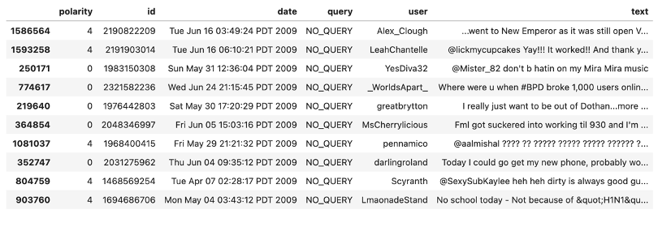
Data
Description of the dataset
The dataset we used is the sentiment140 dataset contains 1,600,000 tweets. The tweets are labeled as 0 if they express negative emotion and as 4 if they express positive emotion. The dataset includes the following fields: polarity (0 = negative, 4 = positive), id, date, query, user, text.
Income Track Tools
Sample size: 20,000

Slide 5
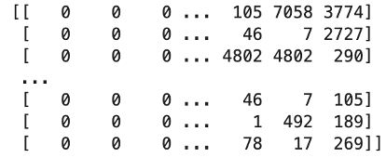
Data
Data preprocessing
Convert label 4 to label 1 for ease understanding
Convert all letters to lower case.
Remove URLs from the text.
Remove usernames (e.g., @SandyM) from the text.
Remove non-alphanumeric symbols such as special characters and emojis, while keeping apostrophes (e.g., in “I’m” and “don’t”).
Expand abbreviations for negative expressions into their full forms.
Apply lemmatization to reduce verbs and nouns to their root form.
Tokenize the data to create sequences of integer indices.
Pad the result to get input data in uniform shape
Dataset was split to train data and test data with a test size of 0.2.
Example of final input train data:

Slide 6
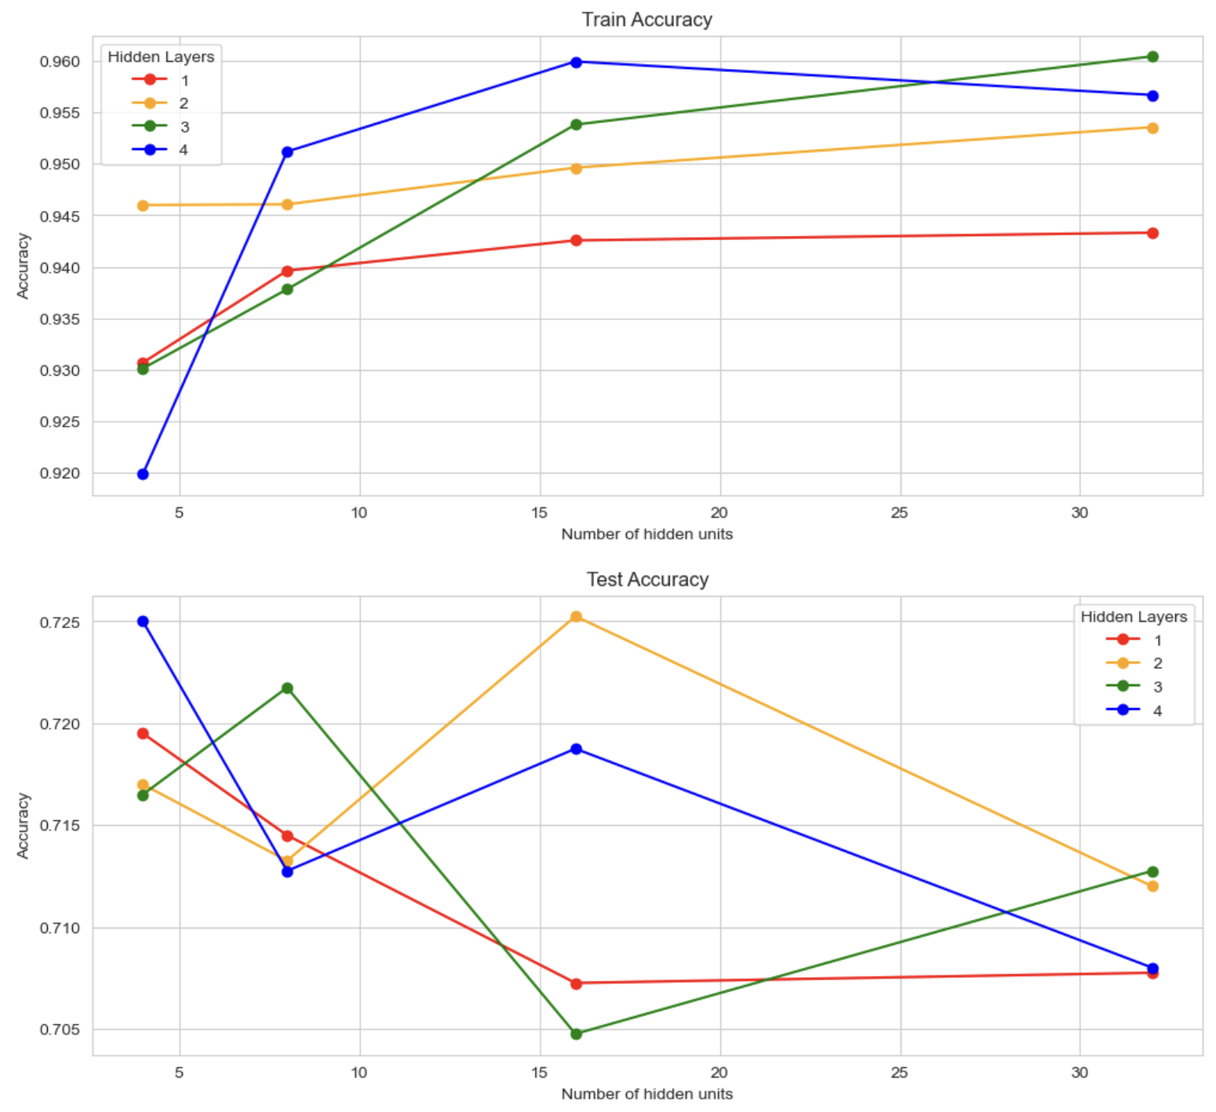
Key Results and Discussion
Hidden Layer
Tested combinations of hidden layers (1–4) and units (4–32).
Training accuracy increased with more layers and units, but test accuracy varied, with poor generalization for extreme configurations.
Deeper networks improve training accuracy but risk overfitting; fewer layers underfit.
Final selection: 2 hidden layers, 16 units.

Slide 7
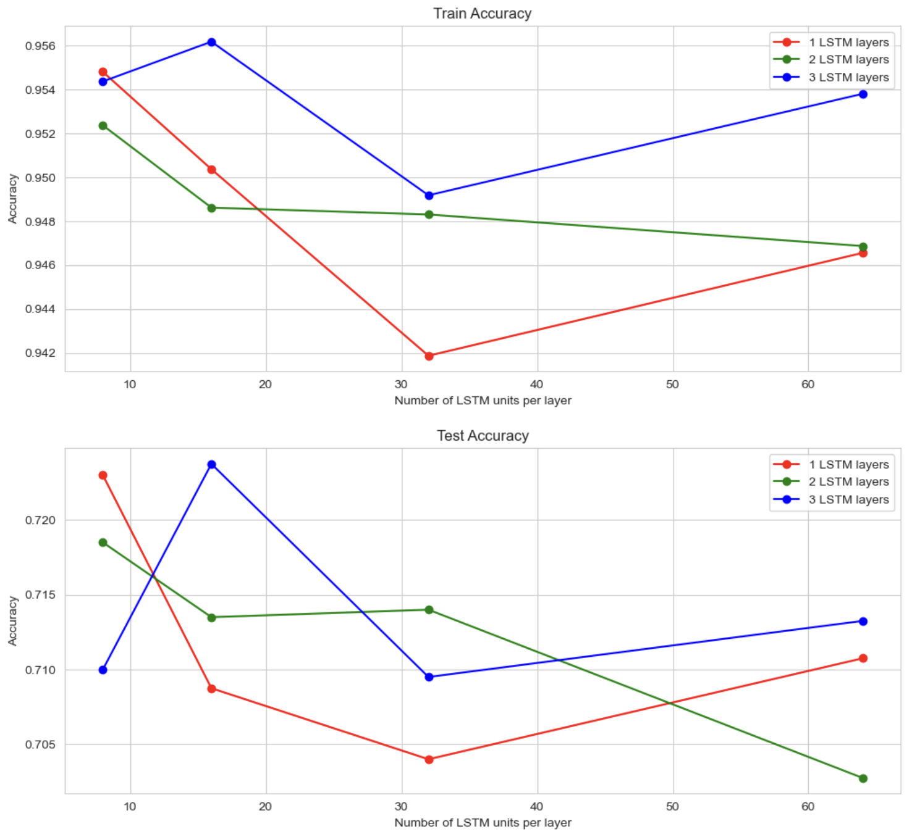
Key Results and Discussion
LSTM Layer
Tested combinations of LSTM layers (1–3) and units (8–64).
Training and test accuracy followed a U-shaped trend; smaller units favored fewer layers, while larger units benefited deeper networks.
Smaller models are efficient for short texts; deeper networks need careful tuning to avoid overfitting.
Final selection: 1 LSTM layer, 8 units.

Slide 8
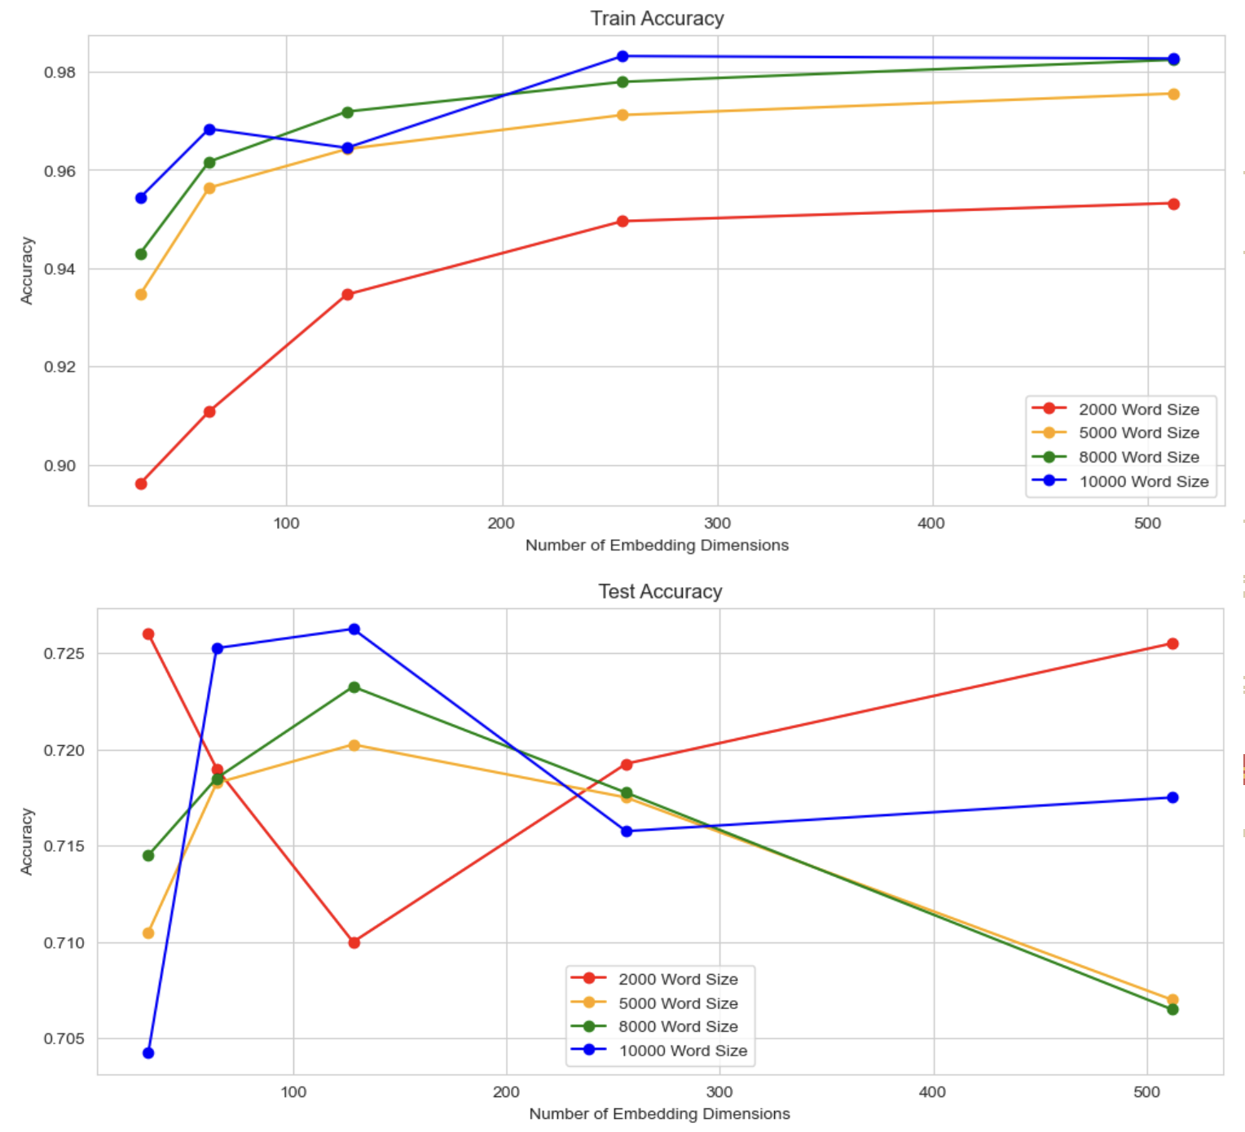
Key Results and Discussion
Embedding Layer
Tested word sizes (1,000–10,000) and embedding dimensions (64–512).
Training accuracy increased with larger word sizes and dimensions; test accuracy peaked with moderate dimensions and higher word sizes.
Larger word sizes capture diverse vocabulary; moderate dimensions balance representation and generalization.
Final selection: word size: 10,000; embedding dimension: 128.

Slide 9
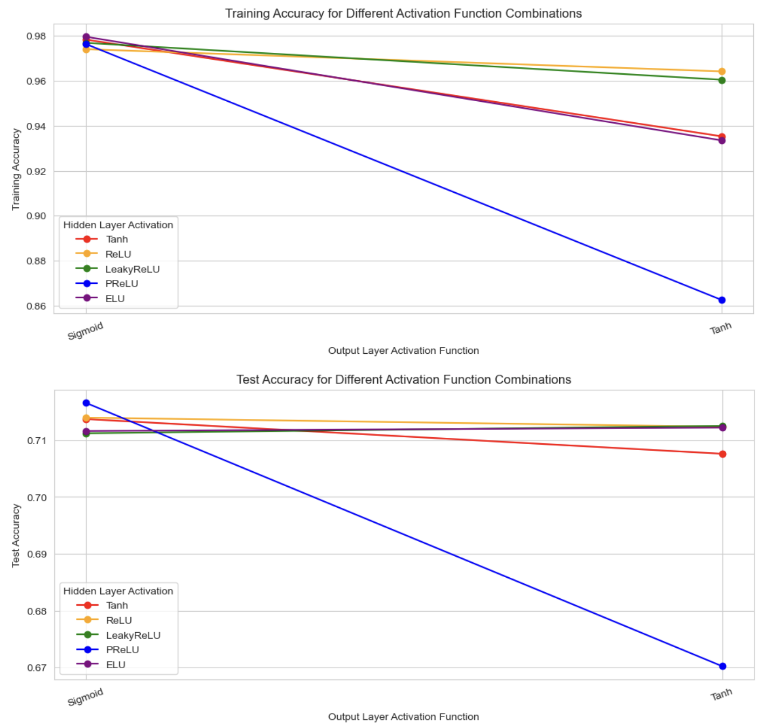
Key Results and Discussion
Activation Function
Tested activation functions for hidden (Tanh, ReLU, LeakyReLU, PReLU, ELU) and output layers (Sigmoid, Tanh).
Output functions showed minimal differences; Hidden functions under Sigmoid performed similarly, with PReLU achieving the highest test accuracy.
PReLU adapts well to data distribution; Sigmoid balances adaptability and probabilistic mapping.
Final activation function for hidden layer: PReLU
Final activation function for output layer: Sigmoid

Slide 10
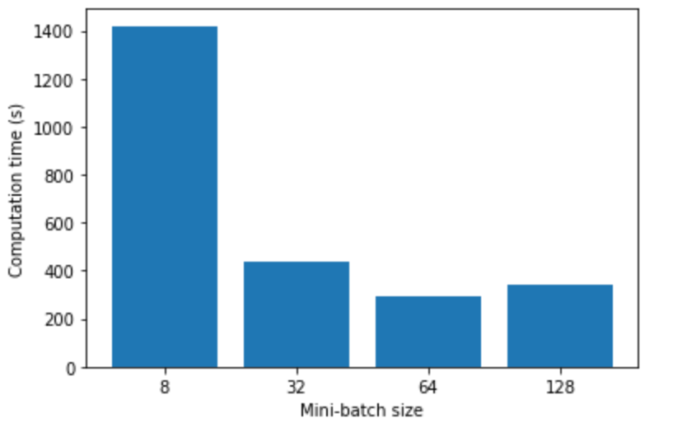
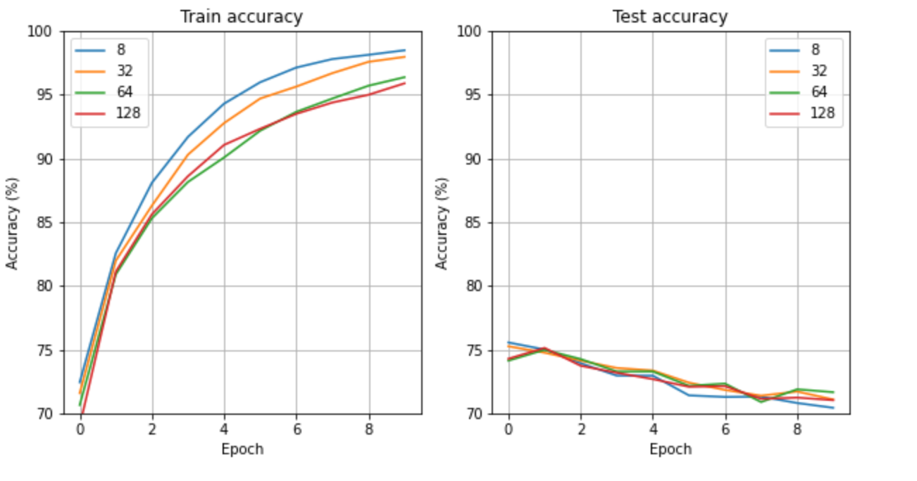
Key Results and Discussion
Mini-Batch size
Tested 4 different batch sizes: 8, 32, 64, and 128.
The batch size of 64 resulted in the shortest training time and the highest final test accuracy.
It did not provide highest train accuracy but prioritizing test accuracy over training accuracy helps improve generalization and reduce the risk of overfitting.
Final batch size: 64

Slide 11
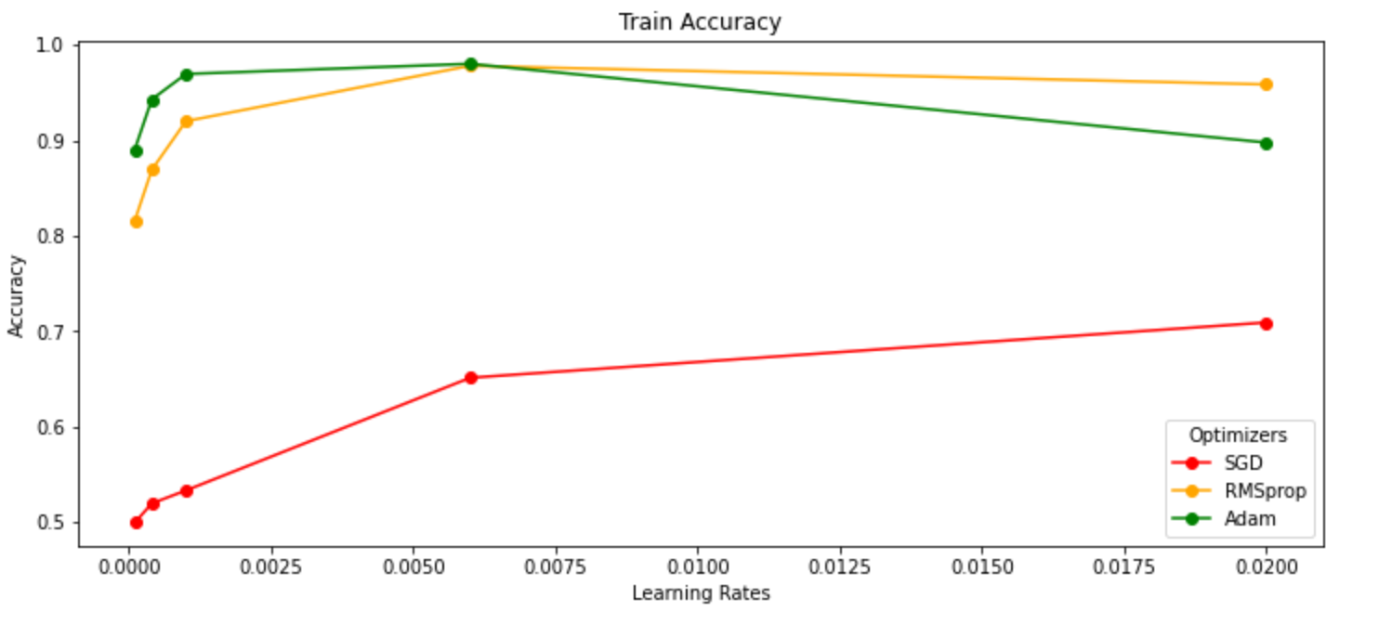
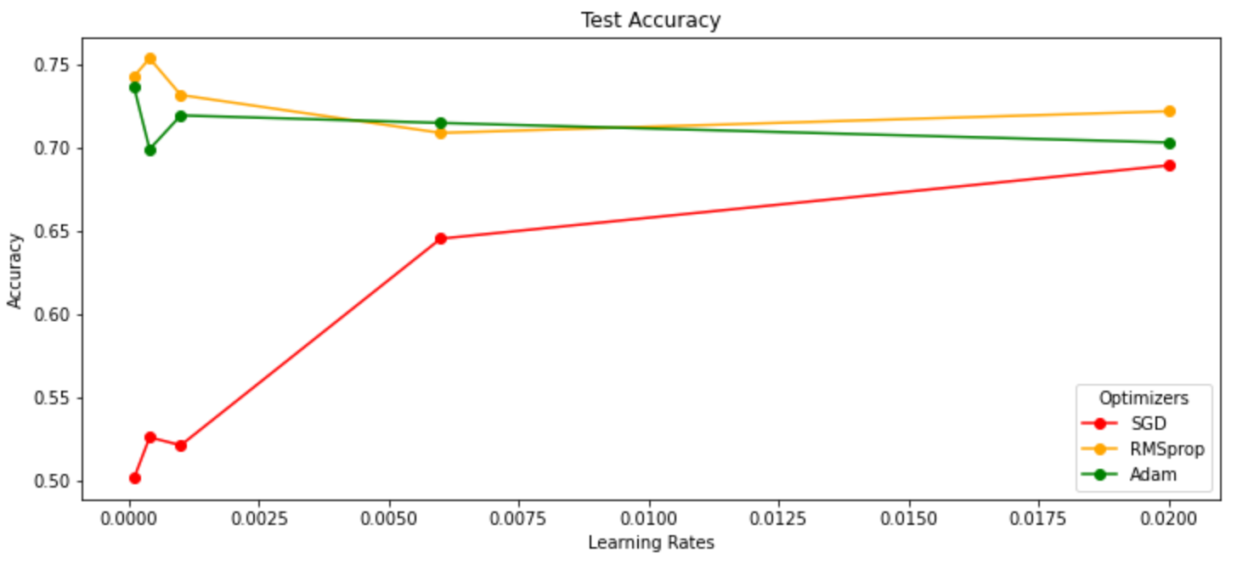
Key Results and Discussion
Optimizer and learning rate
To identify the best combination, we run a nested loop to test each pairing of optimizer—[SGD, RMSprop, Adam]—with learning rates—[0.0001, 0.0004, 0.001, 0.006, 0.02].
RMSprop with a learning rate of 0.0004 yielded the highest test accuracy. However, it also resulted in a final training accuracy below 90%.
To achieve a better balance between training and test accuracy, we selected:
Final optimizer: RMSprop
Final Learning rate: 0.001

Slide 12
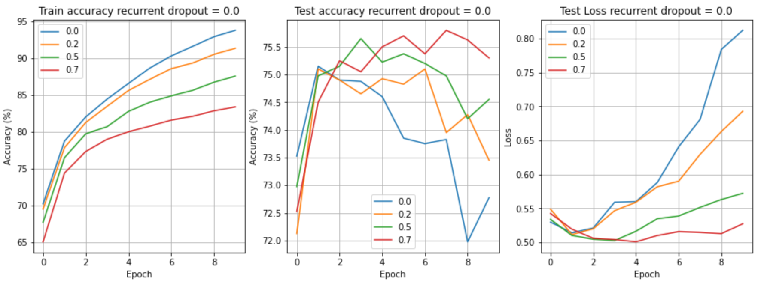
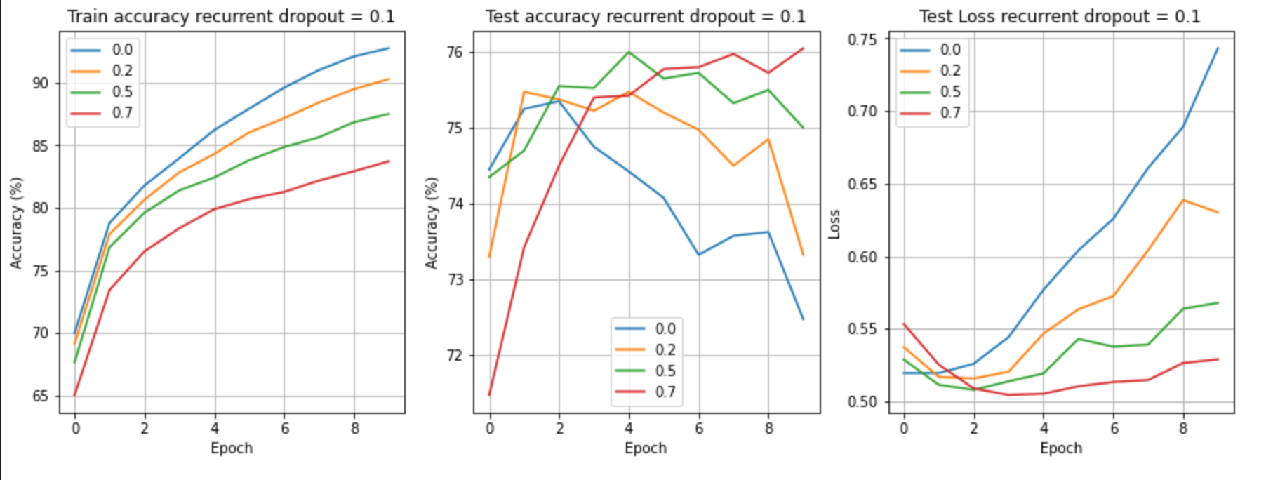
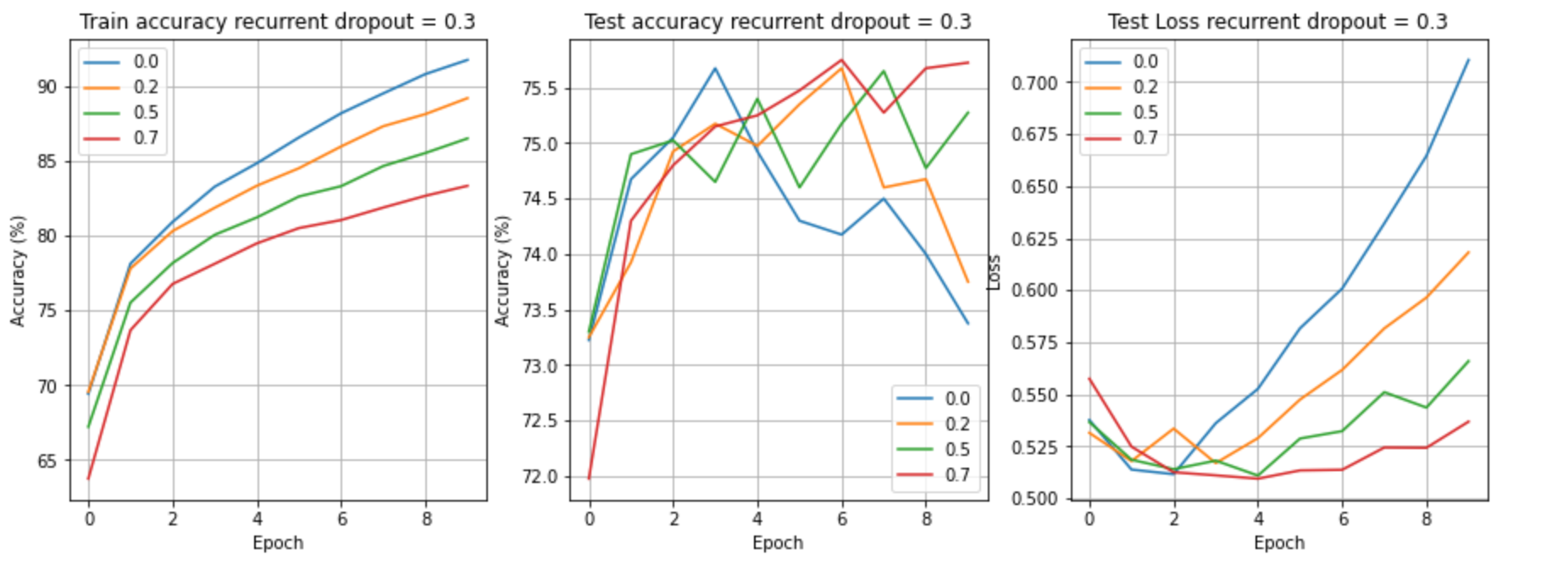
Key Results and Discussion
Dropout Regularization
To determine the optimal combination of dropout and recurrent dropout rates in LSTM layer, we run loops with dropout rates of [0, 0.2, 0.5, 0.7] and recurrent dropout rates of [0, 0.1, 0.3].
Test accuracy often declined and test loss increased over epochs. This indicated the model was failing to generalize well.
These issues were minimized when the regular dropout was set to 0.7 and the recurrent dropout to 0.1.
A high dropout rate helped the model focus on the most significant patterns, thereby improving generalization and overall performance.
Final dropout rate: 0.7
Final recurrent dropout rate: 0.1

Slide 13
Key Results and Discussion
L1, L2 regularization
A high dropout regularization was already applied to the model, more regularization could harm the model’s ability to learn from the data. As a result, neither L1 nor L2 regularization was added to the model.
BCE with logits
Based on our current learning curves, the training loss consistently decreased, indicating that vanishing gradients were not a concern. Moreover, there were no signs of numerical instability or extreme output values. Therefore, the use of BCE with logits was unlikely to address the primary issue our model faced—low generalization. Therefore, standard BCE was selected as the final loss function of the model.
Batch normalization
The batch normalization computed mean and deviation for each batch but did not consider the recurrent part of RNN model, so it did not bring improvement to the model. As a result, batch normalization was not applied in our final model.

Slide 14
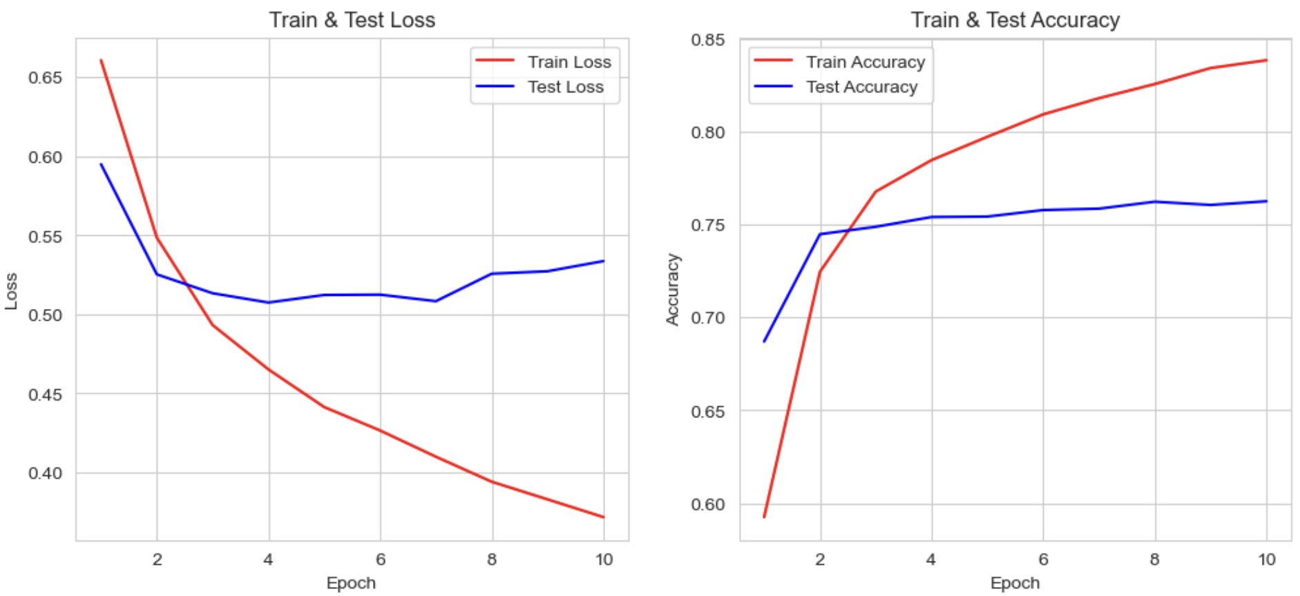
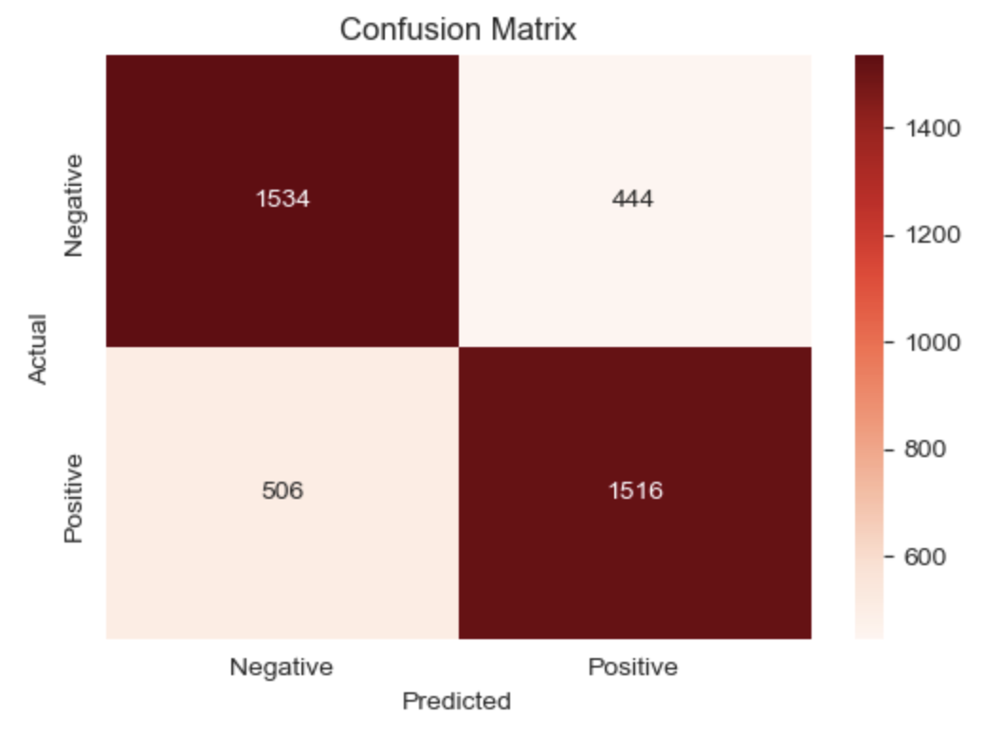
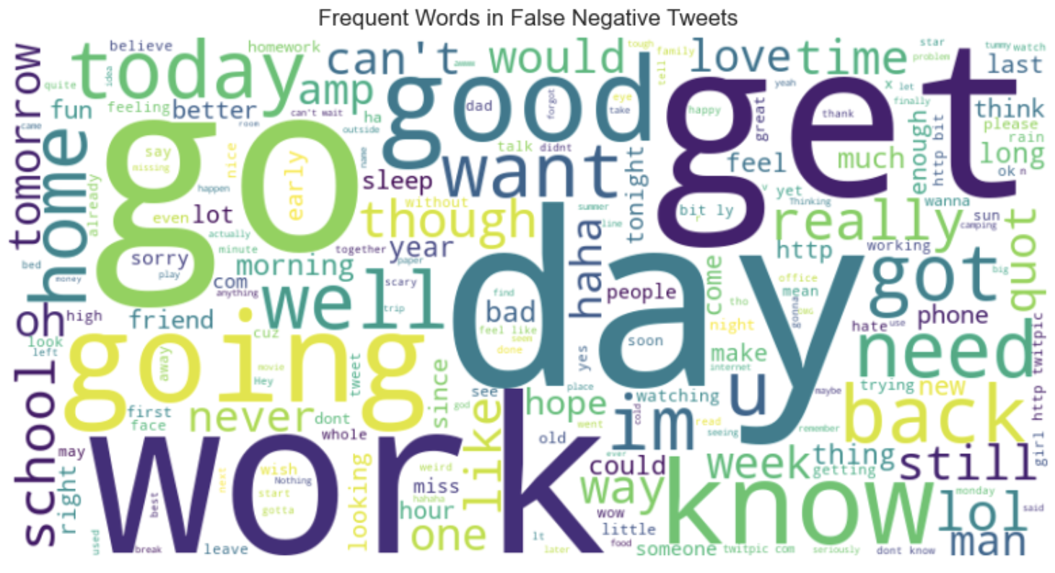
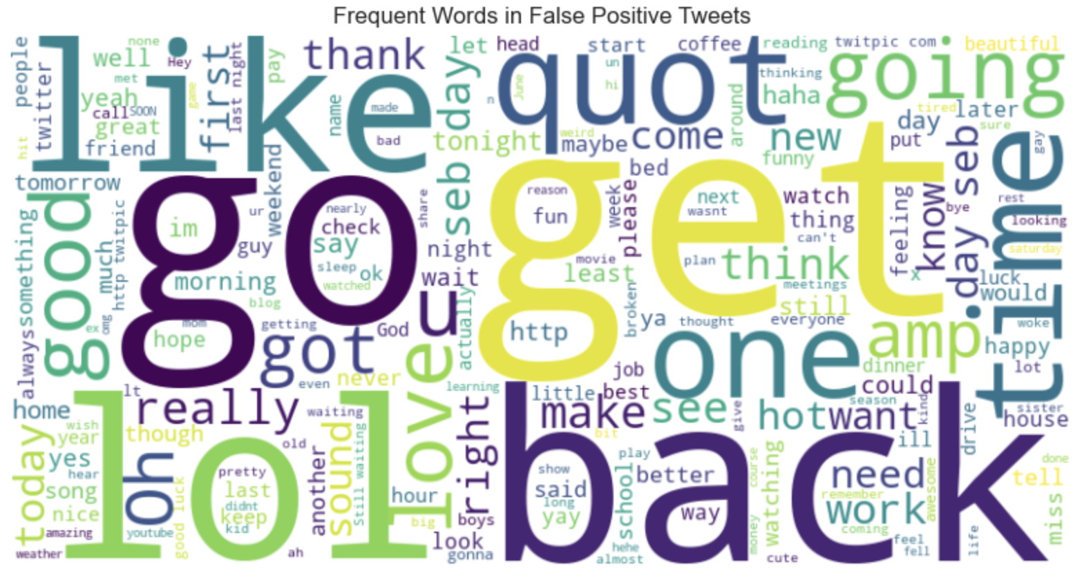
Key Results and Discussion
Model Evaluation
Train loss decreased steadily, but test accuracy plateaued at 75%, indicating overfitting. Improving generalization remains a key challenge.
Error Analysis
Confusion Matrix: The model struggled more with false negatives, misclassifying negative tweets as positive.
Word Clouds: Misclassified tweets reveal challenges with neutral terms and sarcasm, highlighting context interpretation issues.
The model's errors highlight the need to improve context understanding and handle neutral or sarcastic expressions more effectively.

Slide 15
Conclusion
Future Work
Highlights
Regularization Improvement
We implemented an RNN with LSTM to analyze tweet sentiments, addressing sequential data challenges and optimizing hyperparameters like layers, units, and activation functions.
Add dropout to hidden layers and experiment with varying rates to improve generalization.
Significance
Data Preprocessing Optimization
The model achieved 84% training accuracy and 75% test accuracy, demonstrating its effectiveness in sentiment classification, though generalization remains a key area for improvement.
Enhance sentiment-specific features and use data augmentation like back-translation for better context understanding.

